Slide 1


Database Management System Cornerstone Project
ONLINE SHOPPING SYSTEM
Presented by
Under The Guidance of:
Mrs.G.L.Narsamba Vanguri
1. A.N.V.Sai Baba(25B11AI036)
2. A.Santhosh(25B11AI060)
3. T.Bilva(25B11AI133)
4.T.Hemanth Kumar (25B11AIC01)
Department of Artificial Intelligence & Machine Learning

Slide 2
ABSTRACT
PRESENTATION OUTLINE
1. Finalize title, objectives & problem statement
2. Identify entities & attributes
3. Design ER diagram & relationships
4. Prepare relational database schema
5. Define Primary & Foreign Keys
6. Create GitHub repo & responsibilities
7. Database creation & constraints
IMPLEMENTATION & FINAL REVIEW
8. Insert sample data
9. DDL, DML & DQL operations
10. CRUD operations & SQL queries
11. Data integrity & validation
12. Project documentation
13. Demonstrate & present database
14. Conclusion
2

Slide 3
DESIGN
PROBLEM STATEMENT
Traditional shopping can be time-consuming and inconvenient.
Finding and comparing products, prices and availability can be difficult.
Managing customer, order, payment and delivery information manually is difficult.
OUR SOLUTION
A centralized online shopping system that organizes the complete shopping process using a structured database.
OBJECTIVES
01 Easy shopping — Provide a convenient online shopping platform.
02 Product access — Browse and search available products.
03 Cart & orders — Add products to cart and place orders.
04 Data management — Maintain customer, product, category and order data.
05 Payment & delivery — Manage payment and delivery information.
06 Data integrity — Use PKs, FKs and constraints for reliable data.
3

Slide 4
ENTITIES & ATTRIBUTES
CUSTOMER
User information
CATEGORY
Product grouping
PRODUCT
Items for sale
CART
Selected items
ORDERS
Placed purchases
ORDER_ITEM
Products within an order
PAYMENT
Payment records
DELIVERY
Delivery records
The 8 main objects our database needs to store.
4

Slide 5
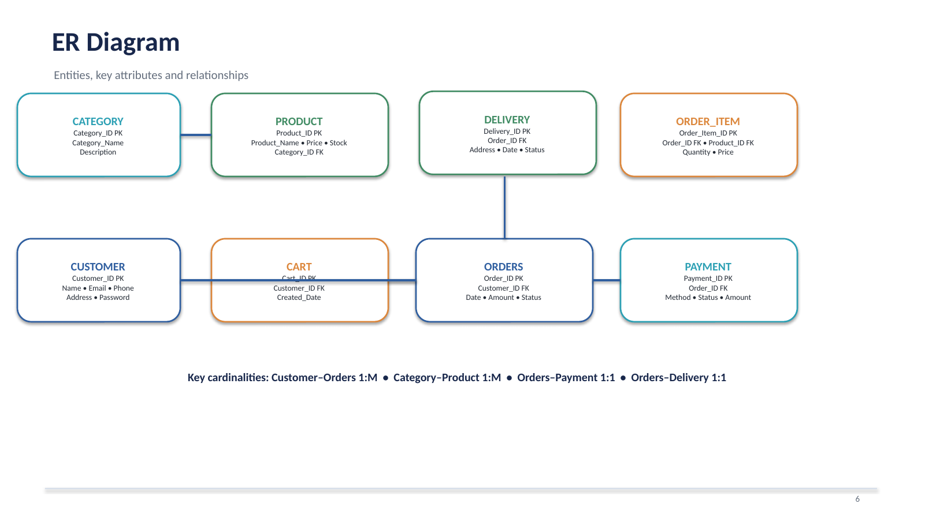
ER DIAGRAM
5

Slide 6
RELATIONAL DATABASE SCHEMA
CUSTOMER
Customer_ID PK | Name | Email | Phone | Address | Password
CATEGORY
Category_ID PK | Category_Name | Description
PRODUCT
Product_ID PK | Product_Name | Price | Stock | Description | Category_ID FK
CART
Cart_ID PK | Customer_ID FK | Created_Date
ORDERS
Order_ID PK | Customer_ID FK | Order_Date | Total_Amount | Order_Status
ORDER_ITEM
Order_Item_ID PK | Order_ID FK | Product_ID FK | Quantity | Price
PAYMENT
Payment_ID PK | Order_ID FK | Payment_Date | Payment_Method | Payment_Status | Amount
DELIVERY
Delivery_ID PK | Order_ID FK | Delivery_Address | Delivery_Date | Delivery_Status
6

Slide 7
PRIMARY & FOREIGN KEYS
PRIMARY KEY (PK)
Uniquely identifies each record.
Customer_ID
Category_ID
Product_ID
Cart_ID
Order_ID
Order_Item_ID
Payment_ID
Delivery_ID
FOREIGN KEY (FK)
Connects one table to another table's primary key.
Product.Category_ID → Category.Category_ID
Orders.Customer_ID → Customer.Customer_ID
Order_Item.Order_ID → Orders.Order_ID
Order_Item.Product_ID → Product.Product_ID
7

Slide 8
GITHUB REPOSITORY & TEAM
online-shopping-system
Repository contents
ER diagram
Schema
Documentation
SQL files
Presentation
Team responsibilities
Divide presentation sections according to each member's strengths.
PROJECT VERSION CONTROL
GitHub stores the project files and provides version control.
The repository contains the ER diagram, relational schema, SQL scripts and presentation materials.
8

Slide 9
DATABASE & CONSTRAINTS
DATABASE
Database: online_shopping
8 tables created:
CUSTOMER • CATEGORY • PRODUCT • CART
ORDERS • ORDER_ITEM • PAYMENT • DELIVERY
CONSTRAINTS
PRIMARY KEY — unique record identification
FOREIGN KEY — connects related tables
NOT NULL — required values
UNIQUE — prevents duplicate email values
CHECK — validates numeric values
DEFAULT — supplies selected default values
9

Slide 10
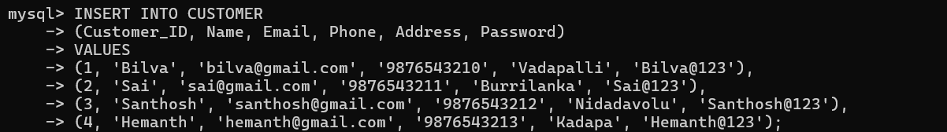
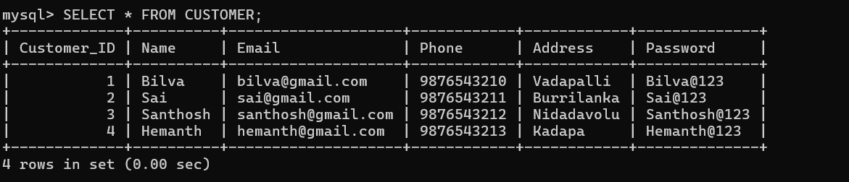
SAMPLE DATA INSERTION
Sample records inserted into the tables
Query : SELECT * FROM CUSTOMER;
Output:
10

Slide 11
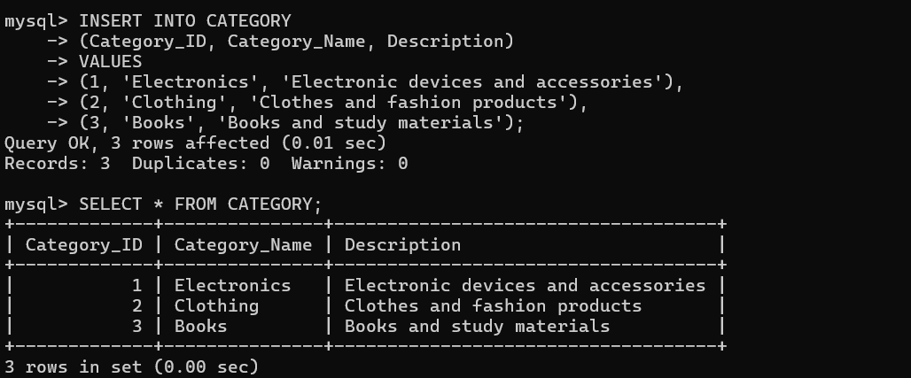
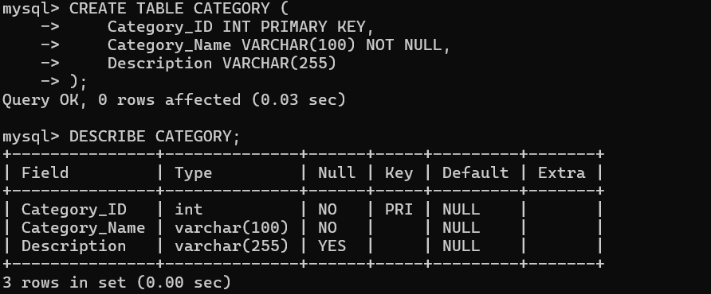
DDL, DML & DQL OPERATIONS
DDL
CREATE — create database objects
ALTER — modify table structure
DROP — remove a demonstration object
DML
INSERT — add records
UPDATE — modify records
DELETE — remove records
DQL
SELECT — retrieve records
WHERE — filter records
ORDER BY — sort results
11

Slide 12
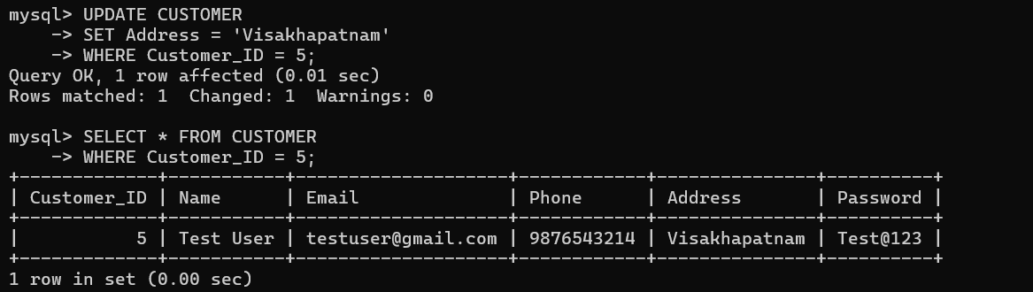
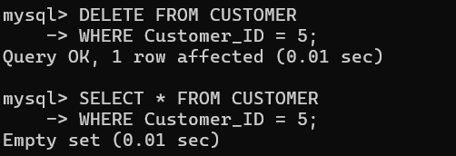
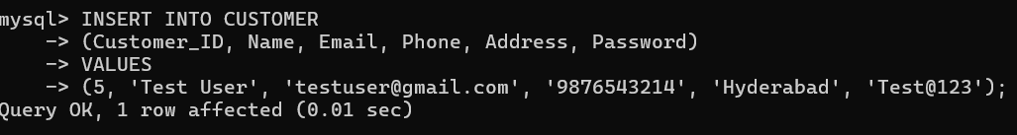
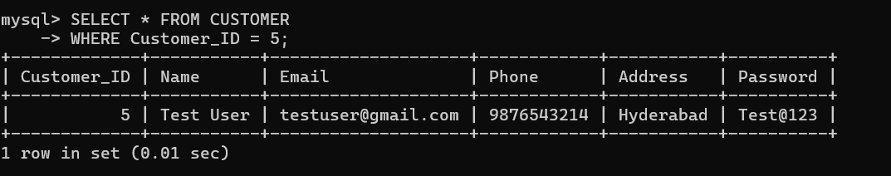
CRUD & SQL QUERIES
CRUD OPERATIONS
CREATE → INSERT → Add records
READ → SELECT → View records
UPDATE → UPDATE → Modify records
DELETE → DELETE → Remove records
SQL QUERIES
WHERE — filter data
ORDER BY — sort results
JOIN — combine related tables
Aggregate functions — COUNT, SUM, AVG, MAX, MIN
12

Slide 13
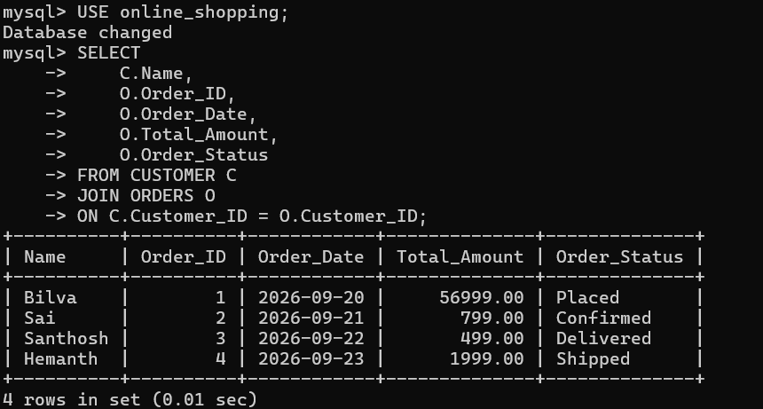
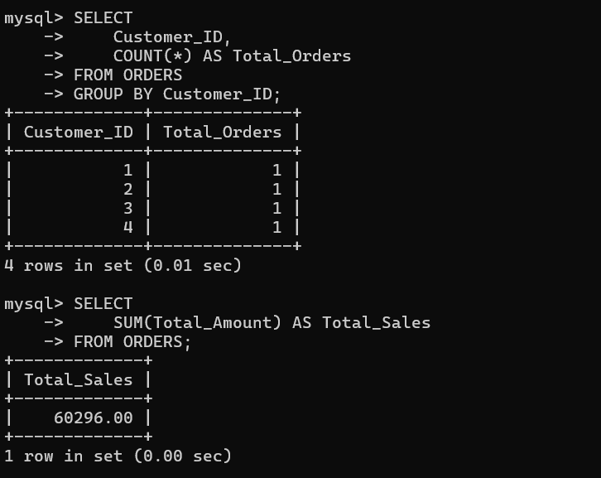
JOIN & AGGREGATE QUERIES
JOIN
Combines related data from CUSTOMER and ORDERS.
SELECT c.Name, o.Order_ID, o.Total_Amount
FROM CUSTOMER c JOIN ORDERS o
ON c.Customer_ID = o.Customer_ID;
AGGREGATE
Summarizes data using COUNT and GROUP BY.
Other functions: SUM() • AVG() • MAX() • MIN() • COUNT()
13

Slide 14
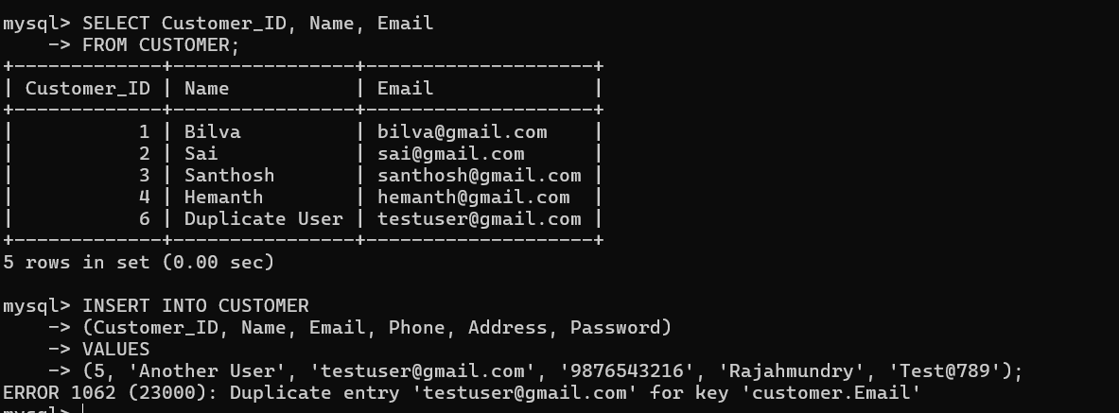
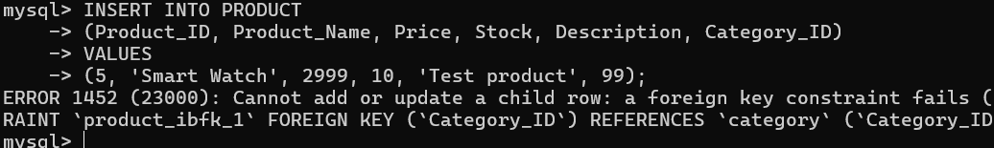
DATA INTEGRITY & VALIDATION
PRIMARY & FOREIGN KEYS
PK uniquely identifies each record.
FK prevents invalid references between related tables.
VALIDATION
NOT NULL prevents missing required values.
UNIQUE prevents duplicate customer email.
CHECK validates numeric values.
DEFAULT supplies selected default values.
TEST CASES
✓ Valid insertion
✗ Duplicate email test — rejected
✗ Invalid foreign-key test — rejected
14

Slide 15
PROJECT DOCUMENTATION
DESIGN DOCUMENTATION
✓ Project title, problem statement and objectives
✓ 8 entities and attributes
✓ ER diagram and relationships
✓ Relational database schema
✓ Primary keys and foreign keys
IMPLEMENTATION EVIDENCE
✓ Database and table creation
✓ Sample data insertion
✓ DDL, DML and DQL operations
✓ CRUD, JOIN and aggregate queries
✓ Data integrity and validation
✓ SQL screenshots and outputs
15

Slide 16
DEMONSTRATE & PRESENT
LIVE DEMONSTRATION FLOW
1. Open MySQL Workbench / MySQL Client
2. Select the online_shopping database
3. Run SHOW TABLES and show the 8 tables
4. Display sample data from the tables
5. Demonstrate DDL, DML and DQL
6. Demonstrate CRUD operations
7. Execute JOIN and aggregate queries
8. Show data-integrity tests
16

Slide 17
CONCLUSION
The Online Shopping System provides a structured relational database for managing customer, category, product, cart, order, payment and delivery information.
Primary and foreign keys establish relationships between tables, while constraints help maintain data integrity.
SQL operations demonstrate practical DBMS concepts for inserting, modifying, deleting, retrieving and analyzing data.

Slide 18
ONLINE SHOPPING SYSTEM
DATABASE IMPLEMENTATION COMPLETE
THANK YOU
QUESTIONS?

